Slide 1
Introduction to DevOps
Sonika Rathi
Assistant Professor
BITS Pilani

Slide 2
Agenda
Operational Methodologies: ITIL
Introduction to ITIL
IT Service Management (ITSM) Lifecycle
ITIL Framework

Slide 3
Operational Methodology
ITIL
ITIL is a framework of best practices for delivering IT services
The ITIL processes within IT Service Management (ITSM) ensure that IT Services are provided in a focused, client-friendly and cost-optimized manner
ITIL’s systematic approach to IT service management can help businesses
Manage risk
Strengthen customer relations
Establish cost-effective practices
And build a stable IT environment
that allows for
Growth
Scale and
Change

Slide 4
ITIL
ITIL : Origin
Developed by the British government's Central Computer and Telecommunications Agency (CCTA) during the 1980s
The ITIL first consisted of more than 30 books, developed and released over time, that codified best practices in information technology accumulated from many sources (including vendors' best practices) around the world
ITIL’s contribution aligned with the ISO/IEC 20000 Service Management standard in 2005
Since 2013, ITIL is owned by Axelos — a joint venture between the Cabinet Office and Capita

Slide 5
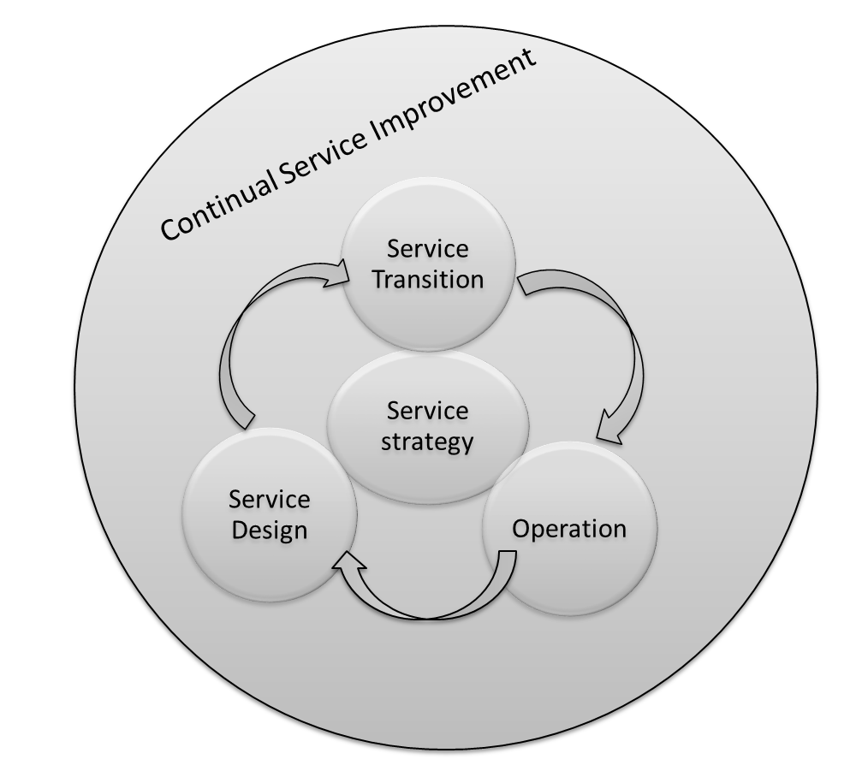
ITIL
IT Service Management (ITSM) Lifecycle
ITIL views ITSM as a lifecycle
Five Phases:
Service Strategy [design, development, and implementation]
Service Design [design and development]
Service Transition [development and design]
Service Operation [delivery and support]
Service Improvement [create and maintain value]

Slide 6
ITIL Framework
Service Strategy
Demand Management
Business Relationship management
Service Design
Service level Management
Continuity Management
Service portfolio Management
Financial Management
Supplier Management
Capacity Management
Availability management
Information Security Management
Service catalogue Management
Design Coordination
Service Transition
Transition Planning and support
Knowledge Management
Service Operation
Event Management
Incident Management
Change Management
Asset and Configuration management
Service validation and testing
Release and Deployment Management
Evaluation
Problem Management
Request Fulfilment
Access Management
Service Desk
Technical Management
Application Management
IT Operations
CSI

Slide 7
ITIL
ITIL: Is a Project?
ITIL is not a “Project”
ITIL is ongoing journey
Benefits of ITIL:
Organizations to reduce the operations cost by optimizing the available resource utilizations
Reduce system outages and minimize the impacts of service unavailability
Even most organizations testified with reduction in business critical incidents by 80 to 90% in few years

Slide 8
Thank You!
In our next session:

